Slide 1


Nathaniel Ding
Aug 2022

Slide 2

Outline
Executive Summary
Introduction
Methodology
Results
Conclusion
Appendix

Slide 3
Executive Summary
Data was collected from SpaceX Wikipedia page and SpaceX API. Data was explored using dashboards, folium maps, visualization and SQL. Data was standardized and used GridSearchCV to find the best parameters for machine learning models
4 machine learning models were produced: K Nearest Neighbours, Decision Tree Classifier, Support Vector Machine and Logistic Regression. All produced similar results except for Decision Tree classifier which was at a lower accuracy rate.

Slide 4
Introduction
Background
Commercial Space Age has arrived
Space X has better pricing ($62 million vs. $165 million USD)
Largely due to ability to recover a part of the rocket (Stage 1)
Space Y wants to compete with Space X
Problem
Space Y has tasks us to train a machine learning model to predict successful Stage 1 recovery

Slide 5

Section 1

Slide 6
Methodology
Executive Summary
Data collection methodology:
Collected and combined data from SpaceX Wikipedia page and public API
Perform data wrangling
Classifying true landings as successful and unsuccessful
Perform exploratory data analysis (EDA) using visualization and SQL
Perform interactive visual analytics using Folium and Plotly Dash
Perform predictive analysis using classification models
Tuned models using GridSearchCV

Slide 7
Data Collection
The data collection process involved web scraping data from a table in SpaceX's Wikipedia page as well as API requests from the SpaceX public API
The following 2 slides will display a flowchart of the data collection process from the API and from web scraping

Slide 8
Data Collection – SpaceX API
GitHub URL:
https://github.com/NatDing/Applied-Data-Science-Capstone/blob/main/jupyter-labs-spacex-data-collection-api.ipynb
Filter data to only include Falcon 9 launches
Request
(Space X APIs)
Imputate missing PayloadMass values with mean
.JSON file + Lists(Launch Site, Booster Version, Payload Data)
Cast dictionary
to a DataFrame
Json_normalize to DataFrame data from JSON
Dictionary relevant data

Slide 9
Data Collection - Scraping
GitHub URL:
https://github.com/NatDing/Applied-Data-Science-Capstone/blob/main/jupyter-labs-webscraping.ipynb
Request Wikipedia
html
Cast dictionary
to Data Frame
Iterate through table cells to extract data to dictionary
BeautifulSoup
html5lib Parser
Find launch info
html table
Create dictionary

Slide 10
Data Wrangling
Created a training label which displays landing outcomes where successful = 1 & failure = 0.
Outcome column has two components: ‘Landing Location’ and ‘Mission Outcome’
New training label column ‘class’ with a value of 1 if ‘Mission Outcome’ is True and 0 if False
GitHub URL:
https://github.com/NatDing/Applied-Data-Science-Capstone/blob/main/labs-jupyter-spacex-Data%20wrangling.ipynb

Slide 11
EDA with Data Visualization
Exploratory Data Analysis performed on the variables: Flight Number, Payload Mass, Launch Site, Orbit, Class and Year
Bar plots, scatter plots and line charts were used to compare relationships between variables to decide if a relationship exists so that they could be used in training the machine learning model
GitHub URL:
https://github.com/NatDing/Applied-Data-Science-Capstone/blob/main/jupyter-labs-eda-dataviz.ipynb

Slide 12
EDA with SQL
Loaded data set into IBM DB2 Database.
Queried using SQL Python integration.
Queries were made to get a better understanding of the dataset.
Queried information about launch site names, mission outcomes, various pay load sizes of customers and booster versions, and landing outcomes
GitHub URL:
https://github.com/NatDing/Applied-Data-Science-Capstone/blob/main/jupyter-labs-eda-sql-coursera_sqllite.ipynb

Slide 13
Build an Interactive Map with Folium
Folium maps mark Launch Sites, successful and unsuccessful landings, and a proximity example to key locations: Railway, Highway, Coast, and City.
This allows us to understand why launch sites may be located where they are. Also visualizes successful landings relative to location.
GitHub URL:
https://github.com/NatDing/Applied-Data-Science-Capstone/blob/main/lab_jupyter_launch_site_location.ipynb

Slide 14
Build a Dashboard with Plotly Dash
Dashboard includes a pie chart and a scatter plot.
Pie chart can be selected to show distribution of successful landings across all launch sites and can be selected to show individual launch site success rates.
Scatter plot takes two inputs: All sites or individual site and payload mass on a slider between 0 and 10000 kg.
The pie chart is used to visualize launch site success rate.
GitHub URL:
https://github.com/NatDing/Applied-Data-Science-Capstone/blob/main/spacex_dash_app.py

Slide 15
Predictive Analysis (Classification)
Split label column
‘Class’ from dataset
Score models on
split test set
Confusion Matrix
for all models
GitHub URL:
https://github.com/NatDing/Applied-Data-Science-Capstone/blob/main/SpaceX_Machine%20Learning%20Prediction_Part_5.ipynb
Fit and Transform
Features using
Standard Scaler
Use GridSearchCV
Decision Tree, and KNN models on
LogReg, SVM
Barplot to compare
scores of models
Train_test_split data
GridSearchCV
(cv=10) to find
optimal parameters

Slide 16
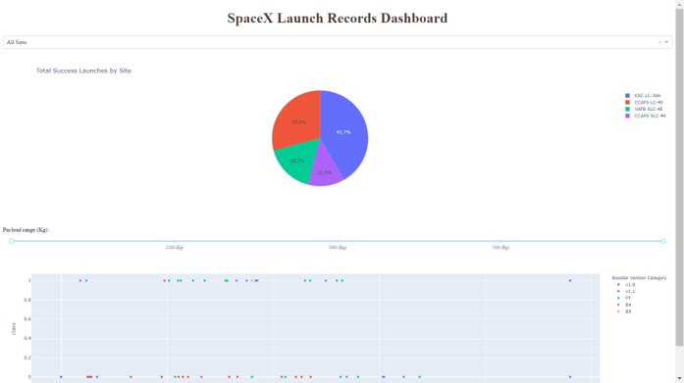
Results
This is a preview of the Plotly dashboard. The following sides will show the results of Interactive Map with Folium, EDA with SQL, EDA with visualization and the results of our model.

Slide 17

Section 2

Slide 18
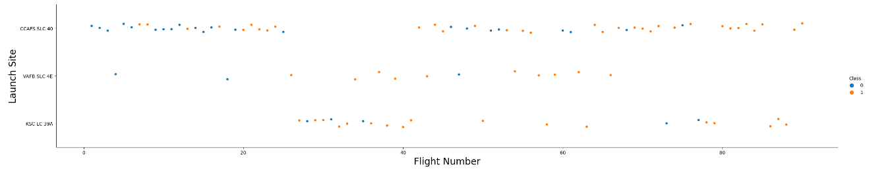
Flight Number vs. Launch Site
Orange indicates successful launch; Blue indicates unsuccessful launch.
The graphic suggests an increase in success rate over time. This is likely due to a big breakthrough around flight 20 which shows significantly increased success rate since that flight. CCAFS seems to be the main launch site as it has the most volume.

Slide 19
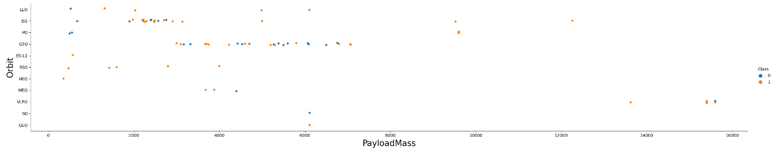
Payload vs. Launch Site
Orange indicates successful launch; Blue indicates unsuccessful launch.
Payload mass fall mostly between 0-6000 kg. Different launch sites also handle different payload masses.

Slide 20
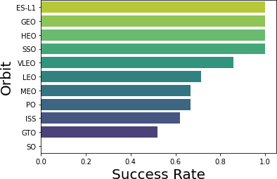
Success Rate vs. Orbit Type
ES-L1 (1), GEO (1), HEO (1) have 100% success rate (sample sizes in parenthesis) SSO (5) has 100% success rate
SO (1) has 0% success rate
GTO (27) has the around 50% success rate but largest sample

Slide 21
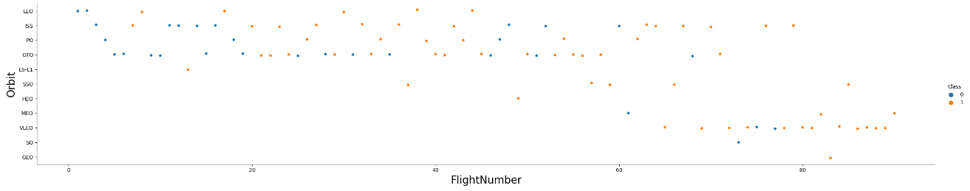
Flight Number vs. Orbit Type
Orange indicates successful launch; Blue indicates unsuccessful launch.
Launch Orbit preferences changes according to Flight Number. Launch Outcome seem to correlate with this preference.
SpaceX started with LEO orbit which saw moderate success and returned to VLEO in recent launches. SpaceX appears to perform better in lower orbits or Sun-synchronous orbits.

Slide 22
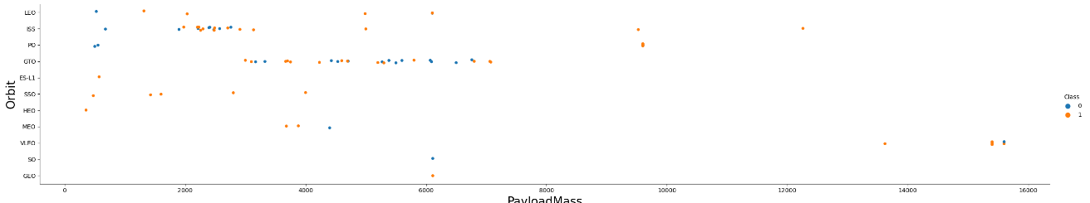
Payload vs. Orbit Type
Orange indicates successful launch; Blue indicates unsuccessful launch.
Payload mass seems to correlate with orbit
LEO and SSO seem to have relatively low payload mass
The other most successful orbit VLEO only has payload mass values in the higher end of the range

Slide 23
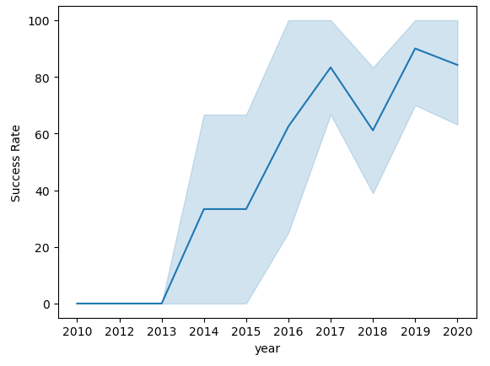
Launch Success Yearly Trend
Success generally increases over time since 2013 with a slight dip in 2018
Success in recent years at around 80%

Slide 24
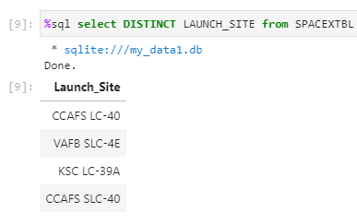
All Launch Site Names
Query unique launch site names from database.
CCAFS LC40 was the previous name. Likely only3 unique launch_site values: CCAFS SLC-40, KSC LC-39A, VAFB SLC-4E

Slide 25
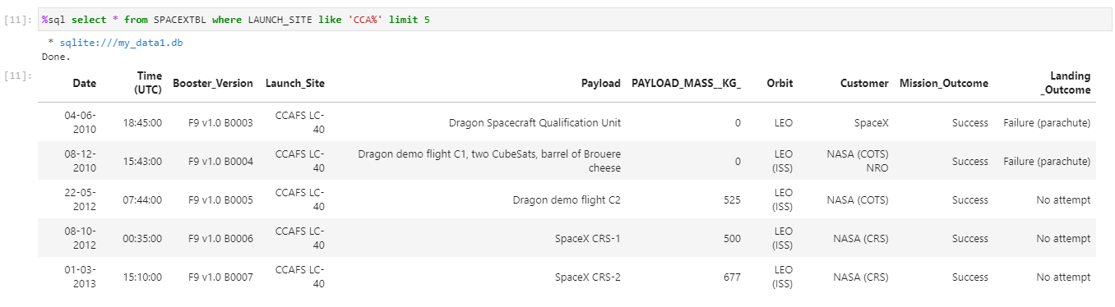
Launch Site Names Begin with 'CCA'
First five entries in database with Launch Site name beginning with CCA.

Slide 26
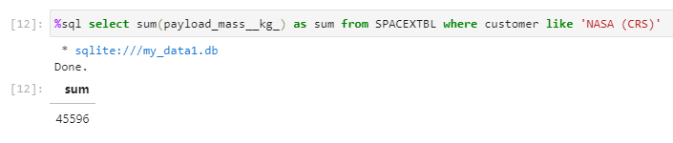
Total Payload Mass
This query sums the total payload mass in kg where NASA was the customer.
CRS stands for Commercial Resupply Services which indicates that these payloads were sent to the International Space Station (ISS).

Slide 27
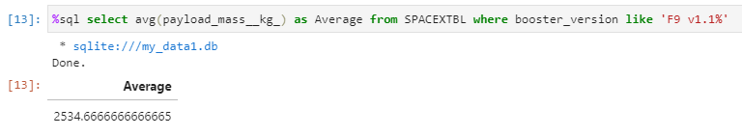
Average Payload Mass by F9 v1.1
This query calculates the average payload mass or launches which used booster versionF9 v1.1
Average payload mass of F9 1.1 is on the low end of our payload mass range

Slide 28
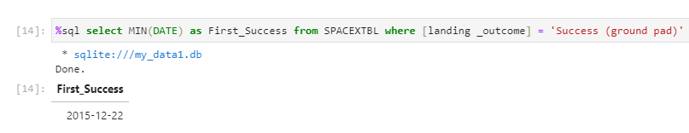
First Successful Ground Landing Date
This query returns the first successful ground pad landing date.
First ground pad landing wasn’t until the end of 2015.

Slide 29
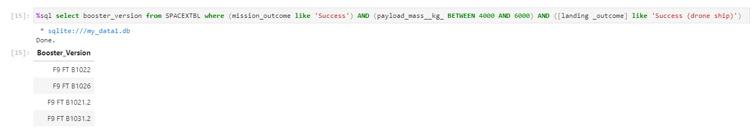
Successful Drone Ship Landing with Payload between 4000 and 6000
This query returns the four booster versions that had successful drone ship landings and a payload mass between 4000 and 6000 non inclusively.

Slide 30
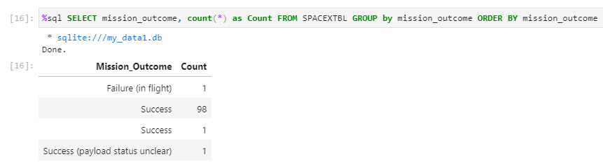
Total Number of Successful and Failure Mission Outcomes
This query returns a count of each mission outcome.
SpaceX appears to achieve its mission outcome nearly 99% of the time.
This means that most of the landing failures are intended.
Interestingly, one launch has an unclear payload status and unfortunately one failed in flight.

Slide 31
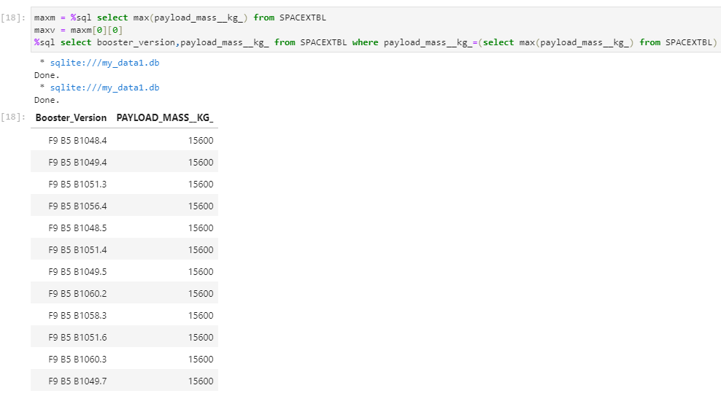
Boosters Carried Maximum Payload
This query returns the booster versions that carried the highest payload mass of 15600 kg.
These booster versions are very similar and all are of the F9 B5 B10xx.x variety.
This likely indicates payload mass correlates with the booster version that is used.

Slide 32
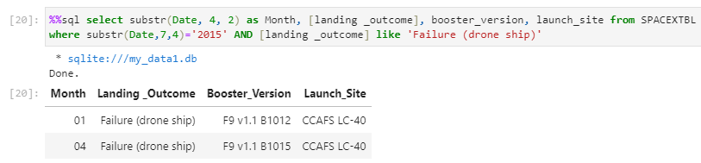
2015 Launch Records
This query returns the Month, LandingOutcome, Booster Version, Payload Mass (kg), and Launch site of 2015 launches where stage 1 failed to land on a drone ship.
There were two such occurrences.

Slide 33
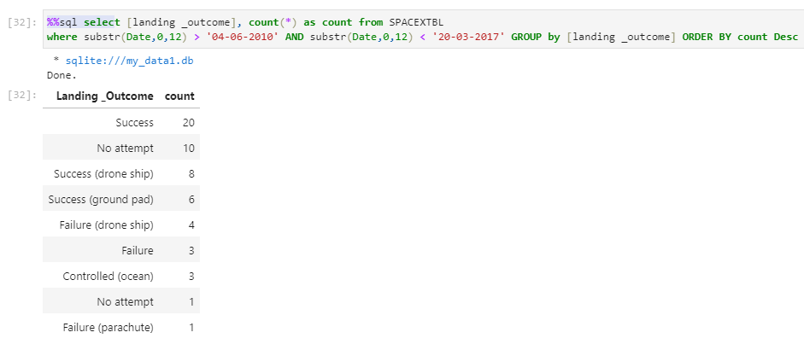
Rank Landing Outcomes Between 2010-06-04 and 2017-03-20
This query returns a list of all landing outcomes between 2010-06-04 and 2017-03-20

Slide 34

Section 3

Slide 35
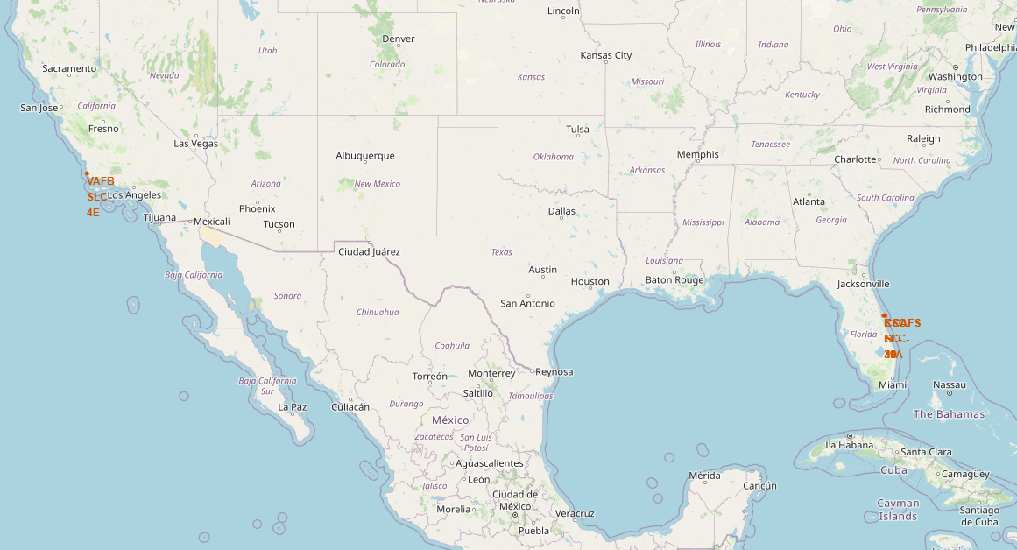
<Folium Map Screenshot 1>
All launch sites are in proximity to the Equator line.
All launch sites are in very close proximity to the coast.

Slide 36
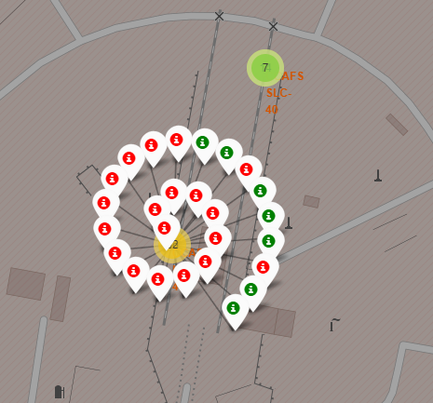
<Folium Map Screenshot 2>
Clusters on Folium map can be clicked on to display each successful landing (green icon) and failed landing (red icon).

Slide 37
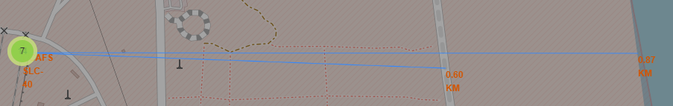
<Folium Map Screenshot 3>
Launch sites are close to highways for supply transport and are close to the coast to ensure a safe distance from populated cities.

Slide 38

Section 4

Slide 39
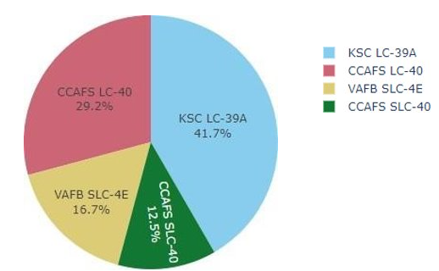
<Dashboard Screenshot 1>
This is the distribution of successful landings acrossall launch sites. VAFB has the smallest share of successful landings. This may be due to smaller sample and increase in difficulty of launching inthe west coast.

Slide 40
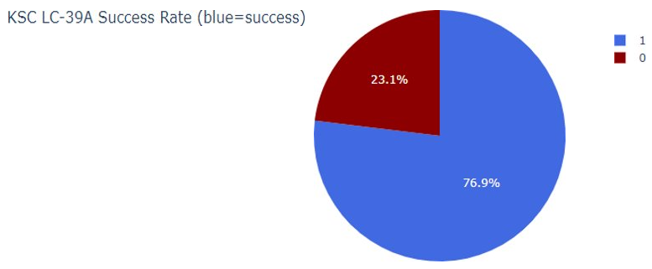
<Dashboard Screenshot 2>
KSC LC-39A has the highest success rate with 10 successful landings and 3 failed landings.

Slide 41

<Dashboard Screenshot 3>
Class indicates 1 for successful landing and 0 for failure. Scatterplot also accounts for booster version category in color and number of launches in point size. In this particular range of 0-6000, interestingly there are two failed landings with payloads of zero kg.

Slide 42

Section 5

Slide 43
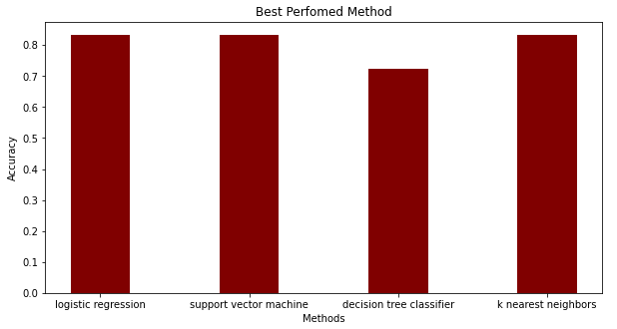
Classification Accuracy
All models had virtually the same accuracy on the test set at 83.33% accuracy. It should be noted that test size is small at only sample size of 18.
This can cause large variance in accuracy results, such as those in Decision Tree Classifier model in repeated runs.
We likely need more data to determine the best model.

Slide 44
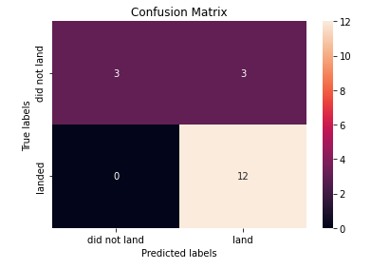
Confusion Matrix
Since all models performed the same for the test set, the confusion matrix is the same across all models. The models predicted 12 successful landings when the true label was successful landing.
The models predicted 3 unsuccessful landings when the true label was unsuccessful landing.
The models predicted 3 successful landings when the true label was unsuccessful landings(false positives). Our models over predict successful landings.

Slide 45
Conclusions
Our task: to develop a machine learning model for Space Y who wants to bid against SpaceX
The goal of model is to predict when Stage 1 will successfully land to save ~$100 million USD
Used data from a public SpaceX API and web scraping SpaceX Wikipedia page
Created data labels and stored data into a DB2 SQL database
Created a dashboard for visualization
We created a machine learning model with an accuracy of 83%
Allon Mask of SpaceY can use this model to predict with relatively high accuracy whether a launch will have a successful Stage 1 landing before launch to determine whether the launch should be made or not
If possible more data should be collected to better determine the best machine learning model and improve accuracy

Slide 46
Appendix
GitHub repository URL:
https://github.com/NatDing/Applied-Data-Science-Capstone

Slide 47


